Slide 1

Trade Signals using Moving Average
Jyoti Prakash behura

Slide 2
Tech Requirements
MATHEMATICAL TECHNIQUES
Moving Average
Bollinger Bands
Relative Strength Index

Slide 3

Methods used
Simple Moving Average (SMA)
Exponential Moving Average (EMA)
An = The price of an asset at period n
n = the number of total periods
α = 2/N+1
N = the length of the window
EMA[today] = the current EMA value
Price[today]=the current closing price
EMA[yesterday]=the previous EMA value

Slide 4
Moving Average crossover Strategy
In the statistics of time-series, and in particular the Stock market technical analysis, a moving-average crossover occurs when on plotting, the two moving averages each based on different time-periods tend to cross.
Uses two moving averages i.e., faster and slower moving average
Faster or short-term moving average has a small window and Slower or long-term on the other hand as longer window.

Slide 5
Generating trade signals
A moving average, as a line by itself, is often overlaid in price charts to indicate price trends. A crossover occurs when a faster moving average (i.e. a shorter period moving average) crosses a slower moving average (i.e. a longer period moving average).
Short-term moving average crosses above the long-term moving average
this indicates buy signal.
Short-term moving average crosses below the long- term moving average
this indicates sell signal.

Slide 6
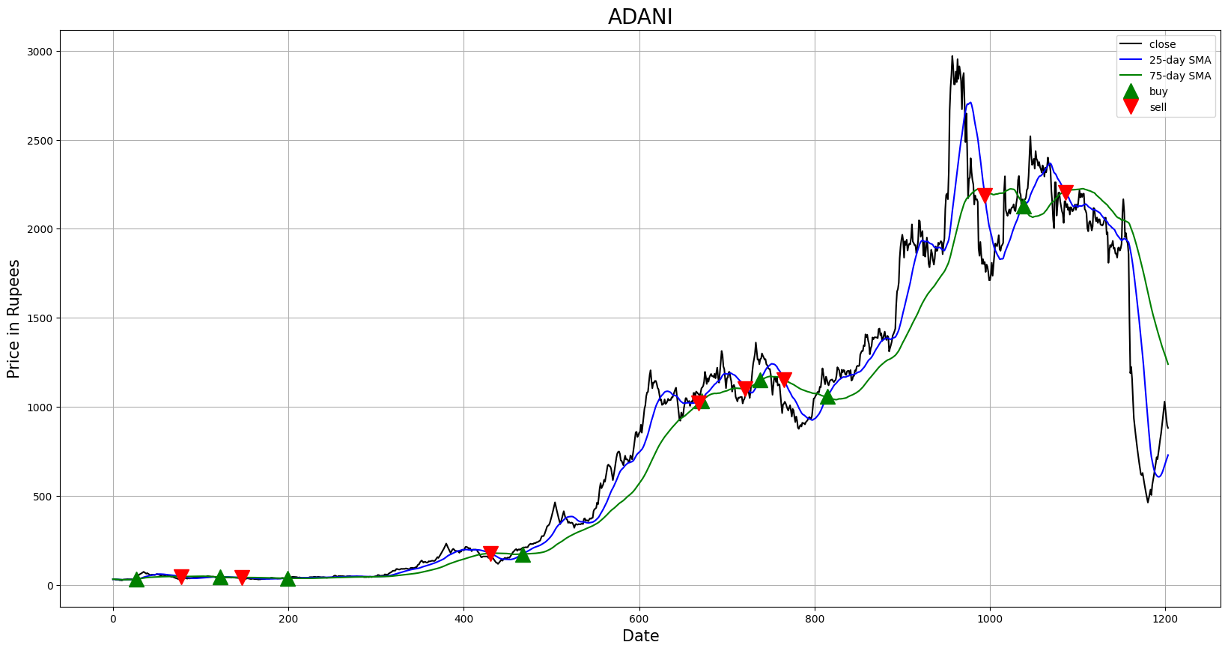
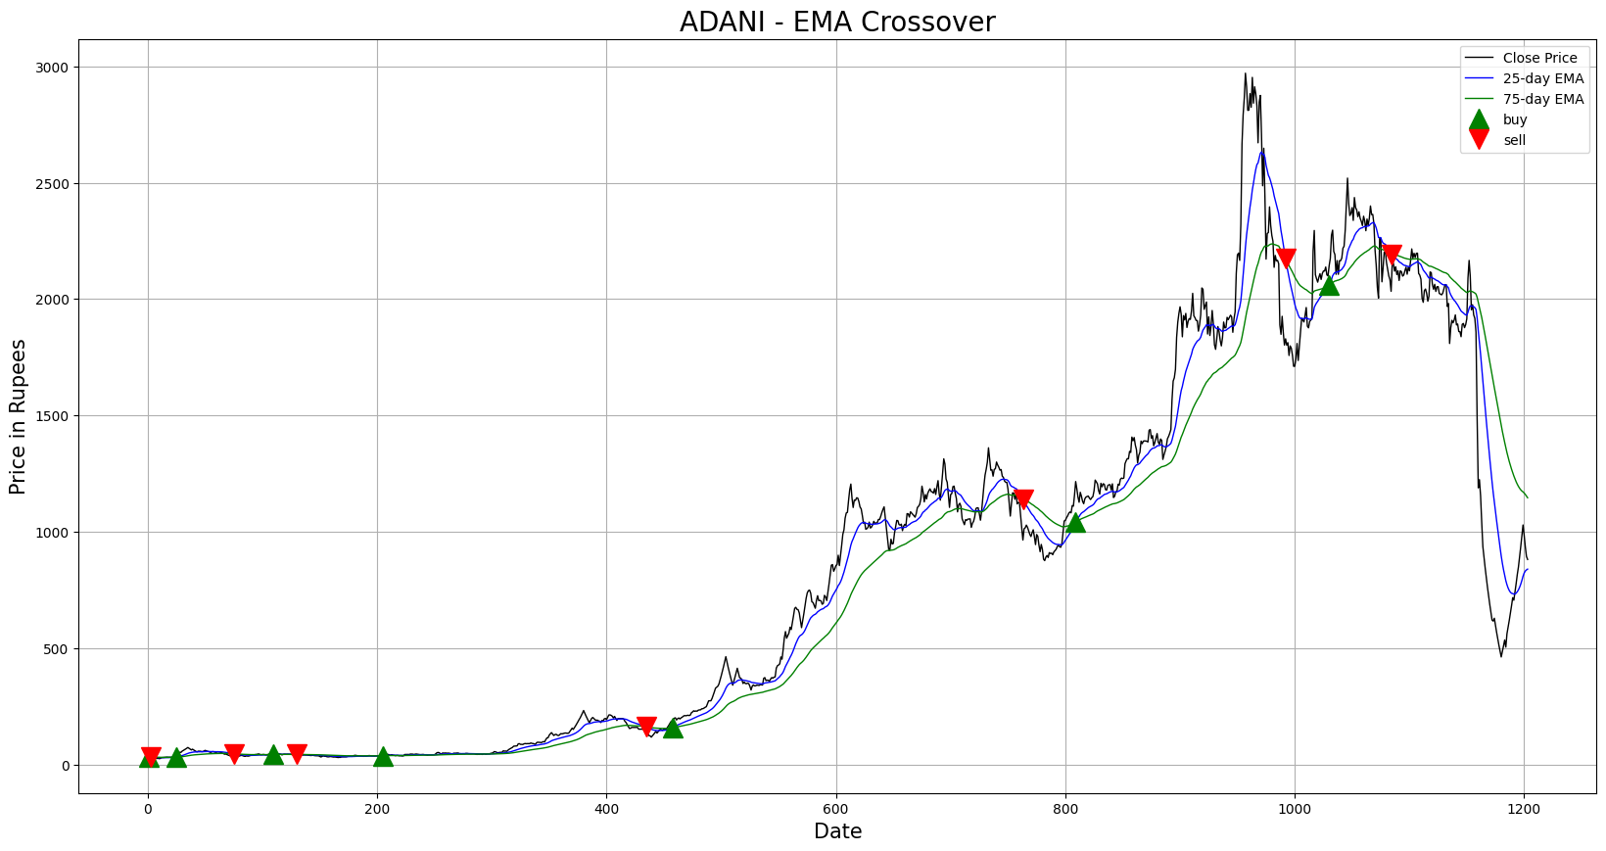
Comparison

Slide 7

WHY EMA IS BETTER
EMA reduces lag
EMA Gives more priority to recent periods
Better representation of the recent performance

Slide 8
EMA Summary
One is not necessarily better than the other
Short term traders use EMA want to be alerted as soon as the price is moving the other way
Long term traders use SMA since these investors aren’t rushing to act and prefer to be less active.

Slide 9
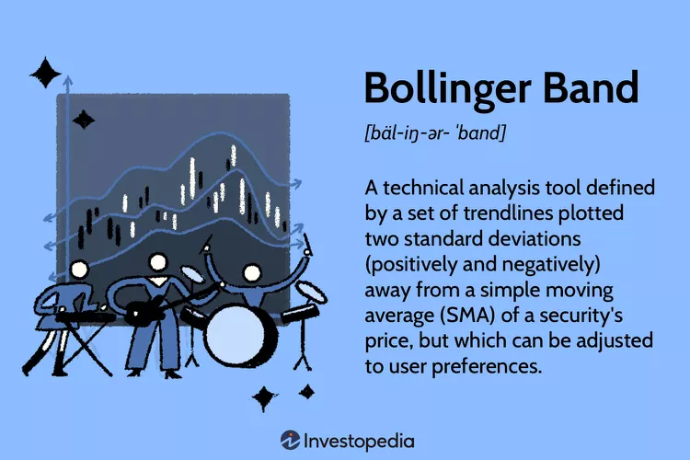
Bollinger Bands
Bands are created by simply adding and subtracting one standard deviation from the moving average.
Standard deviation is a measure of volatility
Periods of low volatility generally tend to be followed by periods of High volatility & vice versa
Identifying prices that move beyond the bands help traders take advantage of unjustifiably high or low prices

Slide 10
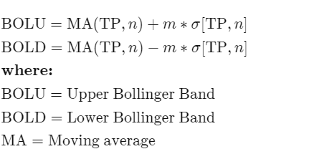


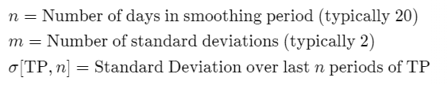
Calculation

Slide 11
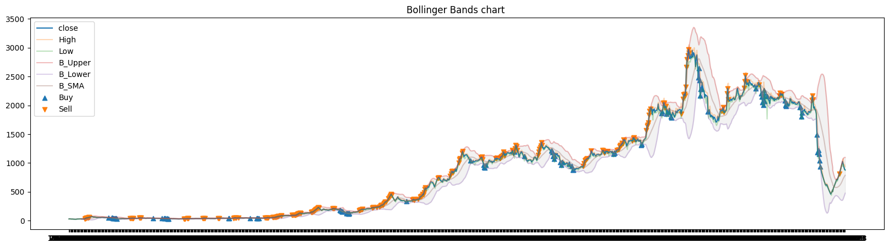
Visualization

Slide 12
Advantages
Bollinger Bands gives traders an idea of where the market is moving based on prices.
Used along the relative strength indicator (RSI) as well as the BandWidth indicator, which is the measure of the width of the bands relative to the middle band.
we should expect that approximately 95% of the time, the observed price action will fall within these bands.

Slide 13

Thank You

